Slide 1
ITEC 2560 Web Client & Server Programming
Welcome!

Slide 2
Introductions
Name, what do you prefer to be called?
Programming classes
Any other programming experience?
(Optional) why you chose this class?
(Optional) something fun you did this summer

Slide 3
Agenda
Course introduction
Syllabus
HTML and CSS
Lab 1

Slide 4
Web Development
Huge industry; practically every organization has a need to work with the web to a greater or lesser degree
Web applications are everywhere, replacing traditional installed applications
Just about everyone has a browser and knows how to use it; so potentially anyone can use your application
Standard user environment: You don't have to think about client installs; no downloads; no need to deal with different hardware/platforms/OS, just need to make your application run on a server, and be viewable in a browser*
A lot of Java, C# code being developed is to power the back end of web applications (eBay, Amazon, Twitter, D2L…)
Mobile apps commonly interact with a web app back end
*This is not trivial, but much easier than building a Windows, Mac, Android, iOS, Linux, Unix…. version of your application

Slide 5
Web Development
Huge variety of tasks that can be accomplished with web technologies
So this is a very useful class to take. Good choice!
Wide variety of technologies have evolved (and continue to evolve) to meet different needs
There's a lot of different web technologies; for different purposes; different technology stacks

Slide 6
Technologies Used in Web Apps
Technologies that are used in (almost) all web applications
HTML, CSS, front end (client-side) JavaScript
Front end frameworks (also JavaScript) to add interactivity in the browser
HTTP and the client/server model
Server application logic
Database(s)
Hosting - where does the server code run?

Slide 7
This Class
But that leaves lots of choice – what server-side tools, frameworks, and languages do we use?
What front-end (client-side) frameworks should we use?
What database will we use?
How do we deploy our websites – what server hardware and software will host the site?

Slide 8
Front End (client-side) technologies
Front end = client side
Client = browser
So front end = things that are run by a browser
HTML - describes the content of a page
CSS - applies styles, colors, layout to the page
JavaScript - interactivity on the page
Vue.js (pronounced 'view' or 'view-j-s') - a JavaScript front end framework - more application logic in the browser
Other frameworks include React and Angular

Slide 9
Vue.js
You may have heard of Angular and React, two front end JS frameworks that are really popular right now
Front end frameworks: used to move application logic to the user's browser, makes websites faster and more responsive once they've loaded, and saves the server a lot of work
But React & Angular are large, complex, and keep changing
We'd need an entire semester to study React or Angular
So, we'll use Vue.js, probably the 3rd most popular now, but less complex and more friendly to learn (although it does have frequent changes and updates too)
Once you know Vue.js, it's much easier to learn React or Angular

Slide 10
Server Code: JavaScript, Node, Express
There's a lot of choices. Server language options include Java, Python, C#, Ruby PHP… most languages can be used to write web apps
We'll use Node.js - JavaScript, for servers
Express.js - web application framework - simplifies common web app tasks
Node.js etc. are growing in popularity and suit small-to-medium sites very well
Trend towards microservices (create several small Nodejs apps, one per specific task) vs. monolithic architecture (e.g. one giant Java/C# app)
Walmart, PayPal, Target, NASA, Wall Street Journal, all use Node
https://medium.com/@DanSiepen/top-15-sites-built-with-node-js-a6412638eb28

Slide 11
Node/Express
Very useful for small-to-medium websites; getting something up and running quickly; but also can deal with high demand sites; robust; good at handling many users simultaneously
The Minneapolis Institute of Arts (MIA) collections website is a Node app https://collections.artsmia.org/
https://github.com/artsmia/art
Strategies, tools and concepts translate to other technology stacks; so what you learn here will be relevant to (for example) C# ASP or Java Server Pages, or Java Spring apps

Slide 12
Databases
Almost all web sites require a database of some kind
We'll use PostgreSQL (usually pronounced 'post-gres') for our databases. We'll use a cloud PostgreSQL service, so you don't need to install it locally
You have taken (or will be taking) a relational database class (SQLServer, MySQL, Access…) and you may know SQLite
If so: PostgreSQL is very similar to other relational databases
If not: don't worry - we'll cover simple database concepts, and we don't need to use advanced features

Slide 13
How we'll structure this class
This class will cover a lot of different technologies; plus software developer tools, and other issues such as user interface design, security…
Web development requires breadth of knowledge
Versus a class like Java or C#, that cover one language in depth

Slide 14
What about Web Design?
This is not a web design class. Clara is most definitely not a web designer!
As we study front end technologies, we'll focus on logical user interface layouts; having the correct components that perform correctly on the page
And use CSS and CSS frameworks to apply styles, and make things look less 1990s
But we won't get into much depth... if you are interested in design, you'll have a foundation to experiment and explore more
It's a whole different industry and set of skills – check out the Graphics and Web Design department's classes if you are interested in learning more
In this class, we are going to focus on making things work; server-side logic and database; providing the correct content and functionality in the client

Slide 15
Pre-requisites
Programming Logic; use of a scripting language e.g. Python
I'll assume you can write basic programs in Python; you understand the concepts of variables; data types; control flow; methods/functions; strings; library functions; lists and dictionaries
You can install software
You have basic command line/terminal skills
You can do research to solve problems that you'll run into
You can look things up; read documentation
Otherwise, we'll start at the beginning; assuming you have no prior knowledge of any web technologies

Slide 16
Syllabus
Quick review
Important parts:
Labs
Online and on campus components
Schedule
Plagiarism policy

Slide 17
Software (for now)
Chrome web browser
Each browser handles HTML, JS and CSS slightly differently. Browser compatibility testing is a important part of production code, but we'll disregard for this class
Programming-centric text editor
VSCode, Notepad++, Atom, Sublime Text, Brackets, WebStorm…
I like VSCode https://code.visualstudio.com/
WebStorm is a JetBrains product but it's very resource-hungry
Install a few, try them out, use the one you like best
You don't need many features - but nice things to have include syntax highlighting, auto-indentation, auto-complete, tabbed editor windows, convenient keyboard shortcut for saving code and other common tasks
Git
Macs already have this
PCs download from https://git-scm.com/

Slide 18
Software (later)
You'll need more software around midterm
Node.js, NPM
vue-cli
Heroku command line toolkit
curl
SQLite
Possibly other tools/applications.
All software needed is free and works on PC, Linux, Mac
Links and instructions will be provided as needed

Slide 19
Questions?
Please ask questions - any time!
I like questions! If you don't feel comfortable asking in front of the whole class, please make a note of your question(s) and ask me in class, office hours, or email

Slide 20
Code* time!
Today: HTML and CSS
HTML = what's the contents of a web page? What elements make up your page?
CSS = what do those elements look like?
*Neither HTML nor CSS are programming languages

Slide 21
Essentials: HTML and CSS
HyperText Markup Language
HTML: what every web page is made of
HTML describes the content of a page: data about the page, and the elements that make up a web page – text, images, tables, video, links, lists, and other resources on a page, and data about these elements
HTML describes page content - what elements are there, how are they organized, what data do they contain, what do they represent?

Slide 22
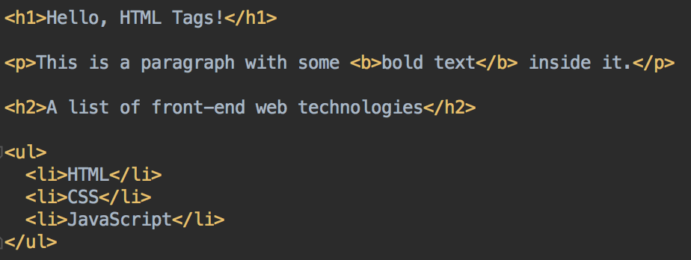
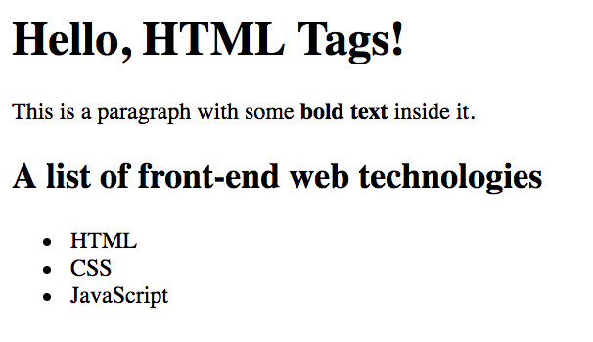
The HTML above will render like this in a browser ->

Slide 23
Essentials: HTML and CSS
HTML is for creating types of elements: a paragraph, an image, a list
HTML is used to define what the content of an element is - text, or image, or video....
HTML elements can be nested to structure and organize the page
For example, a paragraph can contain a list, the list can contain list items

Slide 24
First HTML
Open a text editor
Create a file called hello.html
In your text editor, enter the text on the following slide

Slide 25
<!DOCTYPE html>
<html>
<head>
<title>My first web page</title>
</head>
<body>
<h1>This is my first web page</h1>
<p>
Hello!
</p>
</body>
</html>
hello.html

Slide 26
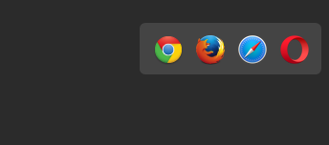
First HTML
Open the hello.html file in your web browser
Either double-click on the file from Explorer/Finder,
Right-click on file, Open in Chrome
or from Chrome; File > Open File… and select hello.html from the directory you've saved it in
If using Webstorm, click on the Chrome icon, top right of the editor window

Slide 27
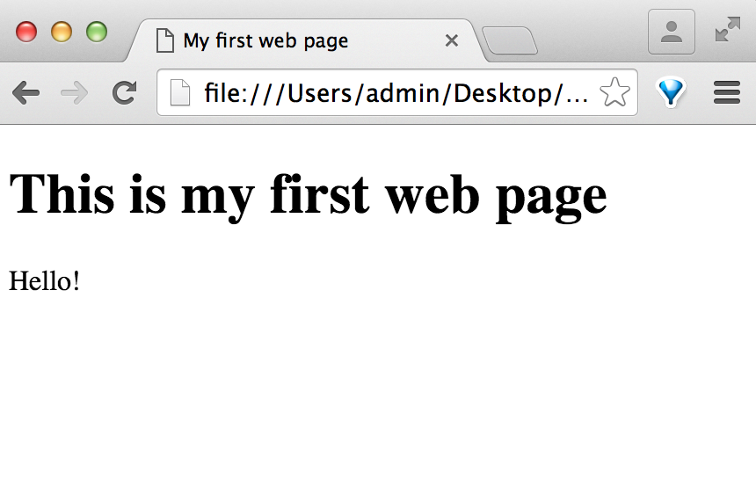
<!DOCTYPE html>
<html>
<head>
<title>My first web page</title>
</head>
<body>
<h1>This is my first web page</h1>
<p>
Hello!
</p>
</body>
</html>

Slide 28
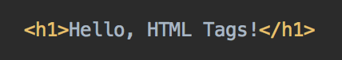
Parts of an HTML Element
Tag name: h1
Contents – in this case, the text Hello, HTML Tags!
Opening tag
Closing tag – note the forward slash /
HTML Element

Slide 29
<!D OCTYPE html>
<html>
<head>
<title>My first web page</title>
</head>
<body>
<h1>This is my first web page</h1>
<p>
Hello!
</p>
</body>
</html>
Specifies this page is HTML5
<head> …. </head>
Information about the page, scripts; metadata; CSS info, information for search engines and web crawlers… Other than the page title, this is not seen by user.
<body>…. </body>
The visible page content

Slide 30
<!DOCTYPE html>
<html>
<head>
<!--metadata e.g. links to stylesheets here -->
</head>
<body>
<!-- document content here -->
<body>
</html>
Well formed HTML follows this format.
Remember this slide: start your pages with this template
(Webstorm provides it for you)

Slide 31
Common HTML Elements
HTML tags are not case sensitive
Indentation doesn't matter; most whitespace is ignored - so if you want a new line on your page, you need to use <p> paragraph or <br> line break elements
Malformed HTML will either be ignored, or your browser will attempt to correct it. It won't crash, but it might not be rendered (displayed) by your browser as you intended

Slide 32
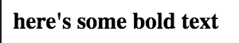
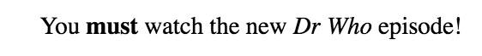
HTML Elements
Start with an opening tag and end with a closing tag*
<b> and </b> in this example
<b>here's some bold text</b>
Can nest tags inside other tags
<p>You <b>must</b> watch the new <i>Dr Who</i> episode!</p>
Make sure tags are completely contained in their parent tag; and each open tag has a matching closing tag
A closing tag always belongs to the closest opening tag of the same type
*Some exceptions, like comments, br, img and link elements

Slide 33
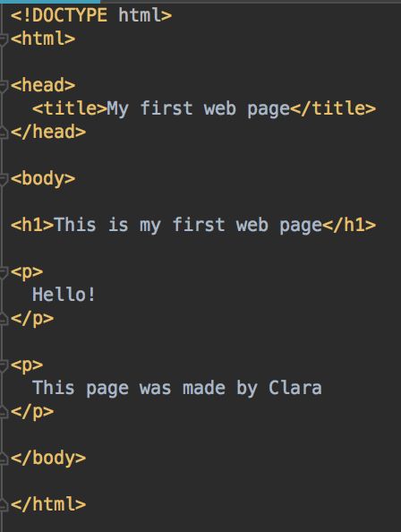
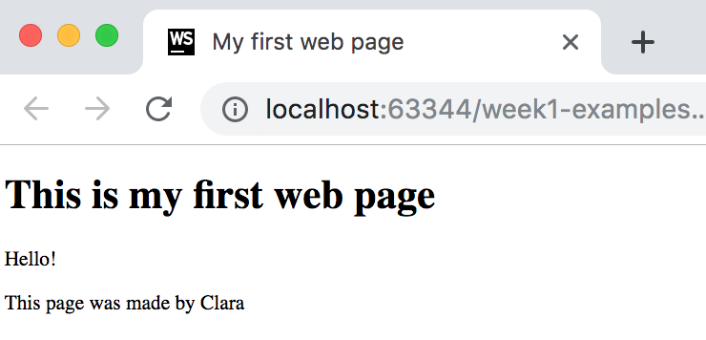
Your turn
After the Hello! paragraph, add another paragraph that says who created this page,
Use your own name, not mine
Use <p> and </p> tags
Save hello.txt, and refresh the page in your browser
Do you see the new text on your page?

Slide 34
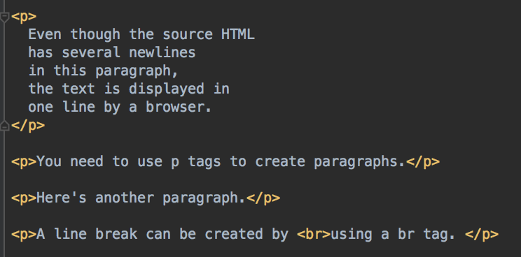
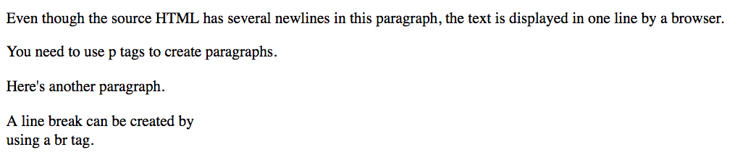
Paragraphs and Line Breaks
Paragraphs; enclose text in <p>…</p> tags
Line breaks: single <br> tag

Slide 35
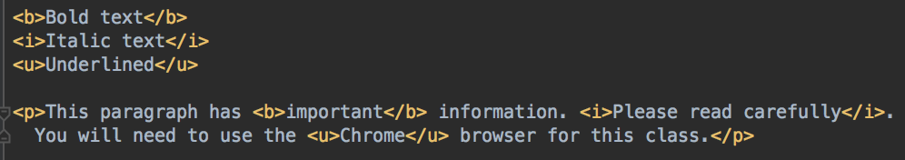
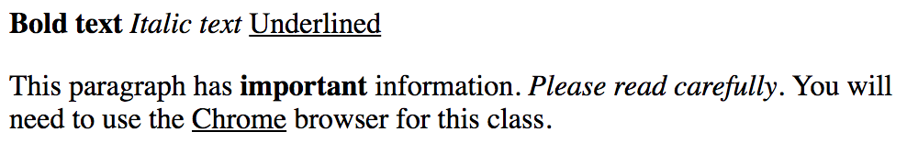
Text Formatting Tags
<b>Bold text</b>
<i>Italic text</i>
<u>Underlined</u>

Slide 36
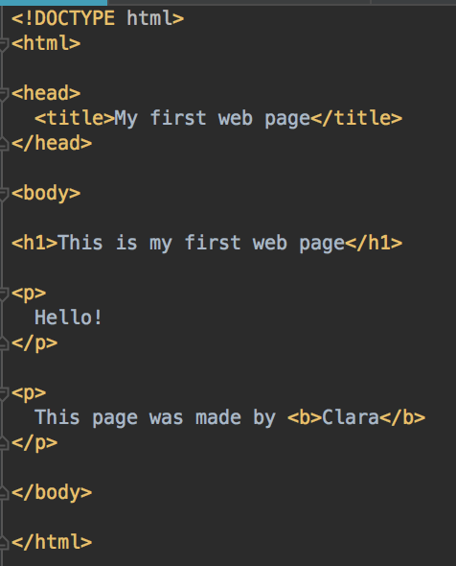
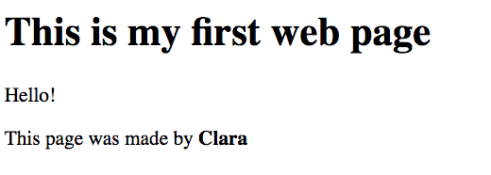
Your turn
Use <b> tags to make your name bold
Save and refresh the page, confirm page renders correctly

Slide 37
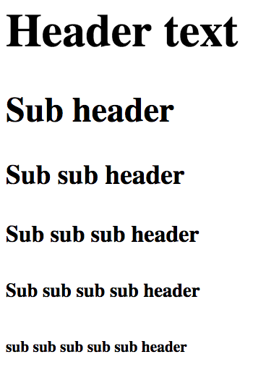
Text Formatting Tags - Headings
h1 through h6 tags used to make different level headings in a page
<h1>Header text</h1>
<h2>Sub header</h2>
<h3>Sub sub header</h3>
<h4>Sub sub sub header</h4>
<h5>Sub sub sub sub header</h5>
<h6>sub sub sub sub sub header</h6>

Slide 38
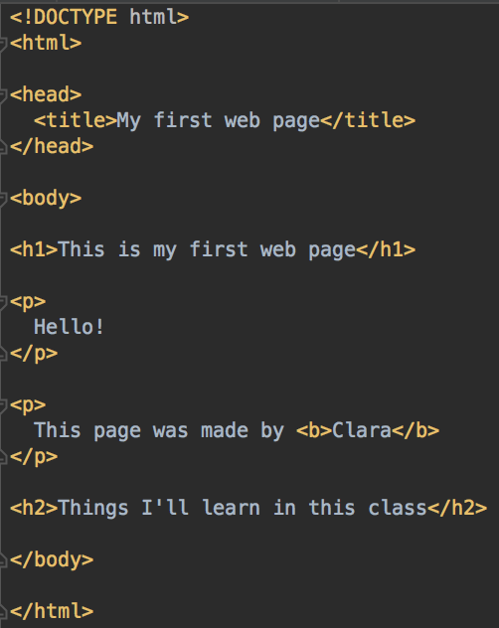
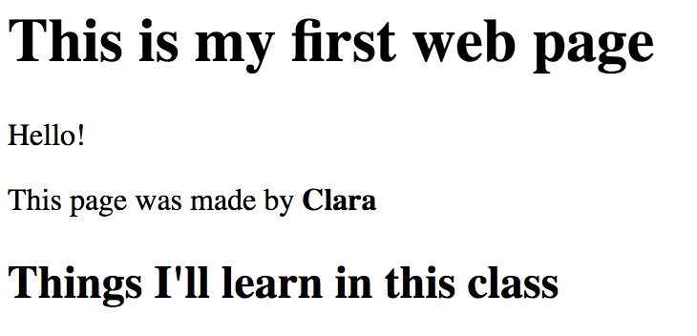
Your turn
Add a sub heading, using h2 tags, with the text Things I'll learn in this class

Slide 39
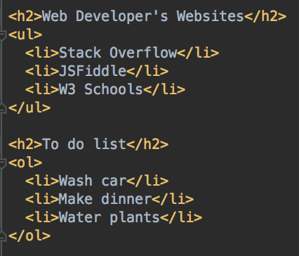
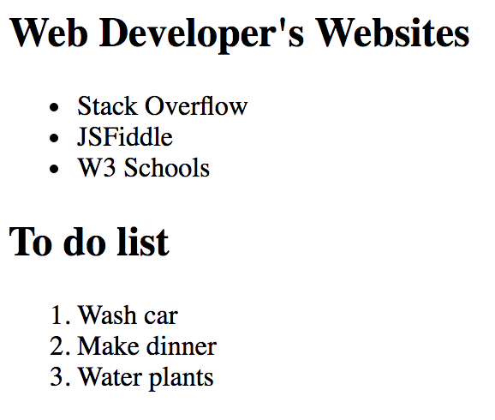
Lists
Two types of lists
<ol> ordered (numbered)
<ul> unordered (bullet points)
Nest <li> list item elements inside <ol> or <ul> elements to create each list item element

Slide 40
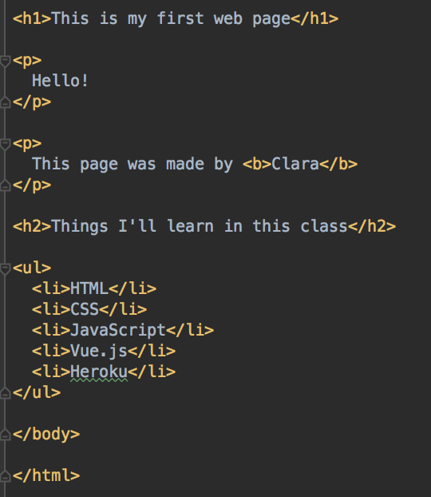
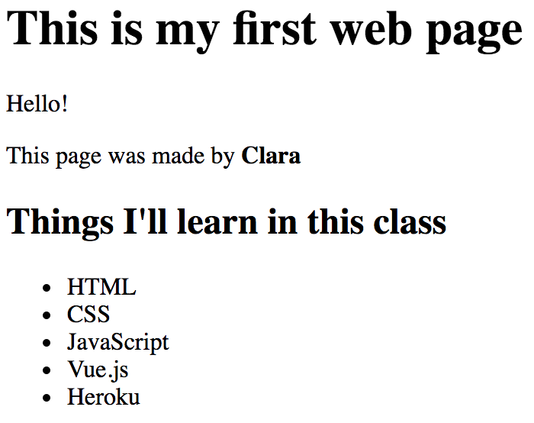
Your turn
After your <h2>Things I'll learn in this class</h2>, create a new unordered list
How many other technologies do you remember?
Top of page omitted

Slide 41
HTML: Links
Use the <a> tag for links
Specify the link target with the href attribute
Can specify the URL as a relative link, for another page on your own site
Or a full URL (including http or https) to an external site
Text inside the <a>… </a> tags will be the link text
<a href="http://www.minneapolis.edu">MCTC</a>
<a href="http://www.stackoverflow.com">Stack Overflow</a>
<a href="home.html">To Home Page</a>
Relative to current page
home.html must exist or the link won't work

Slide 42
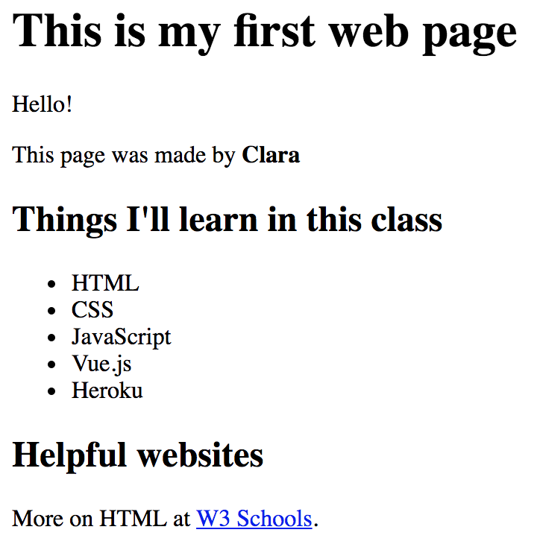
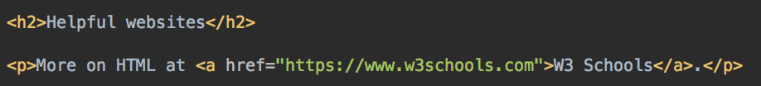
Your turn
Add a link to W3Schools.com https://www.w3schools.com/ to your page
Optional - another heading, put the link in a paragraph
Click on the link and make sure it works!

Slide 43
Essentials: HTML and CSS
HTML elements can have attributes
Specifying the URL for a link - href attribute in an a element
Specifying the source of an image file for a image element, or the alt-text, or tooltip text
adding a unique id to identify one particular element on a page;
or giving many elements the same class, to identify elements of the same
Many other attributes

Slide 44
HTML Elements with Attributes
Tag name: a
Contents – in this case, link text
Attribute inside tag, as name="value"
Use double quotes
Opening tag
Closing tag
Element
An element can have many attributes. Separate name="value" pairs with spaces

Slide 45
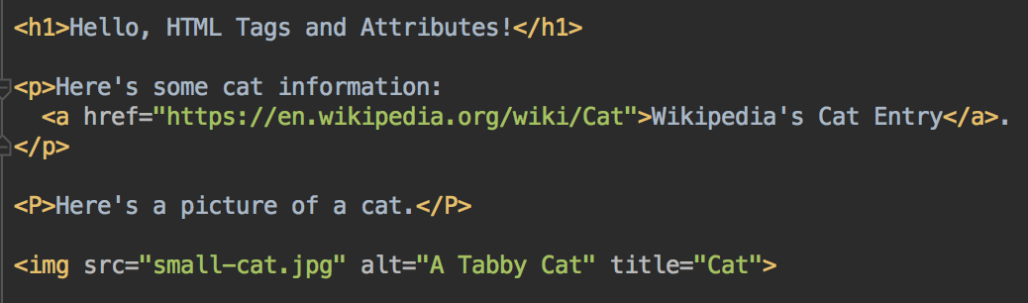
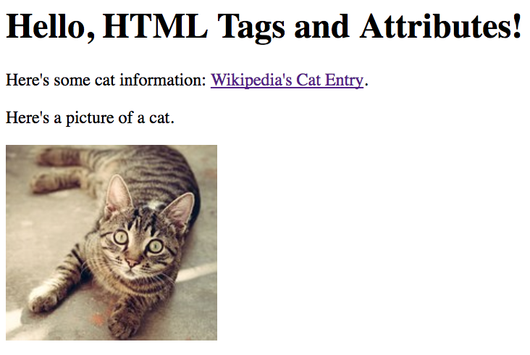
HTML Element Attributes
The link is created with an a tag with one attribute:
href attribute for the URL. Required.
The image is created with an img tag. It has 3 attributes:
src attribute for the image file. Required.
alt attribute for alt–text (for screen-readers or text that is displayed if the image can't. Optional but recommended.
title attribute, displayed as a tool-tip when the image is hovered over. Optional.

Slide 46

More HTML: Images
<img src="http://placekitten.com/g/450/350">
<img src="http://placekitten.com/g/450/350" height="100" width="100">
Use the <img> tag for images. No close tag needed. Specify the location of the image as a src attribute
src can be absolute or relative
Can specify size with height and/or width attributes. Image will be scaled proportionately if you only specify either height or width attribute

Slide 47
Where to get images?
Use images that you own - pictures you took/created
Use public domain images or licensed for reuse
Wikimedia commons, https://commons.wikimedia.org/wiki/Main_Page
Pixabay.com, Libreshot, Unsplash.com, various others
Use a placeholder image generator
http://www.hanselman.com/blog/TheInternetsBestPlaceholderImageSitesForWebDevelopment.aspx
Be aware of reuse restrictions on images owned by others; ensure that you only use images that you have permission to

Slide 48
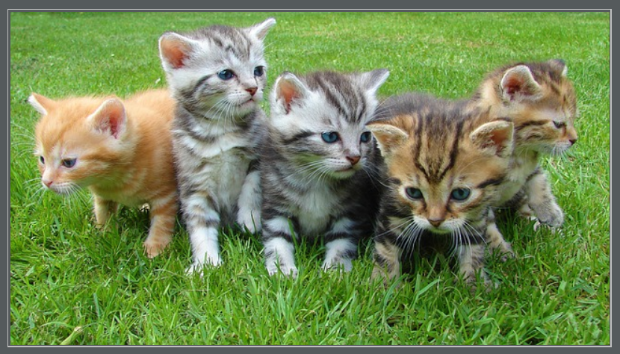
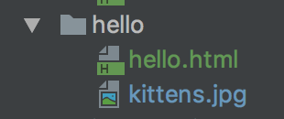
Your Turn
Get an image: download an image from https://www.unsplash.com or another free image site
Save the image in the same directory as your hello.html file
https://pixabay.com/photos/kittens-cat-cat-puppy-rush-555822/

Slide 49
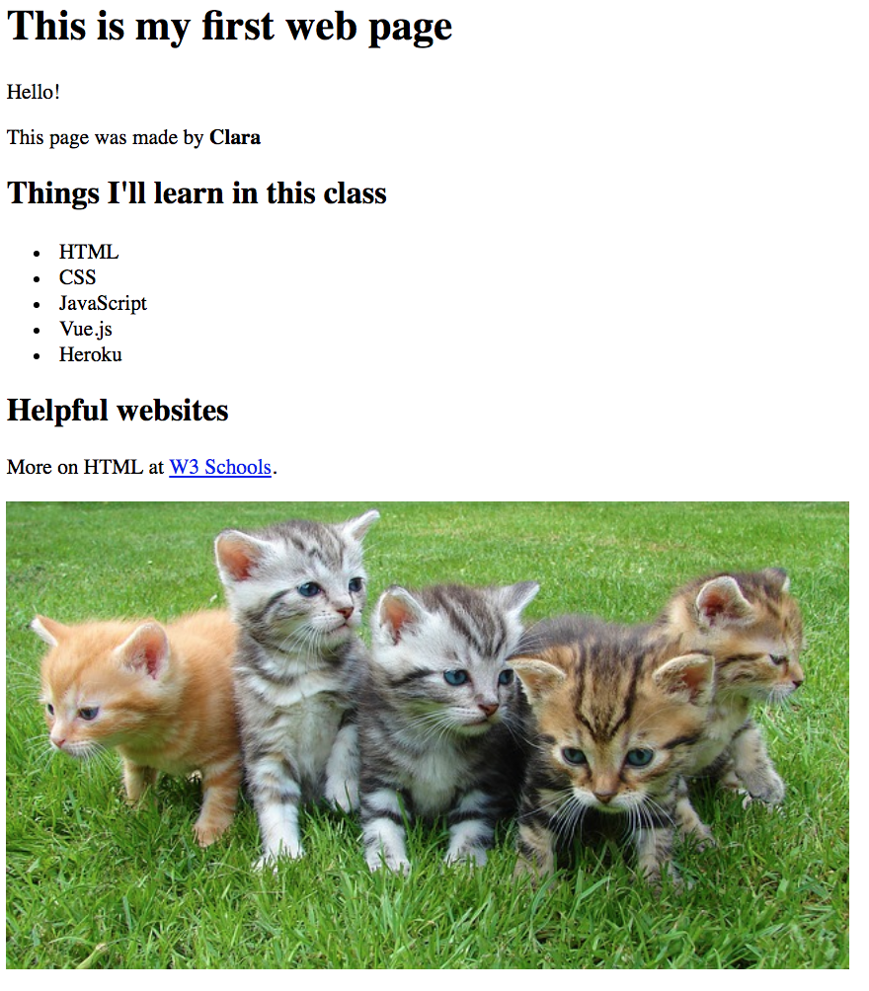
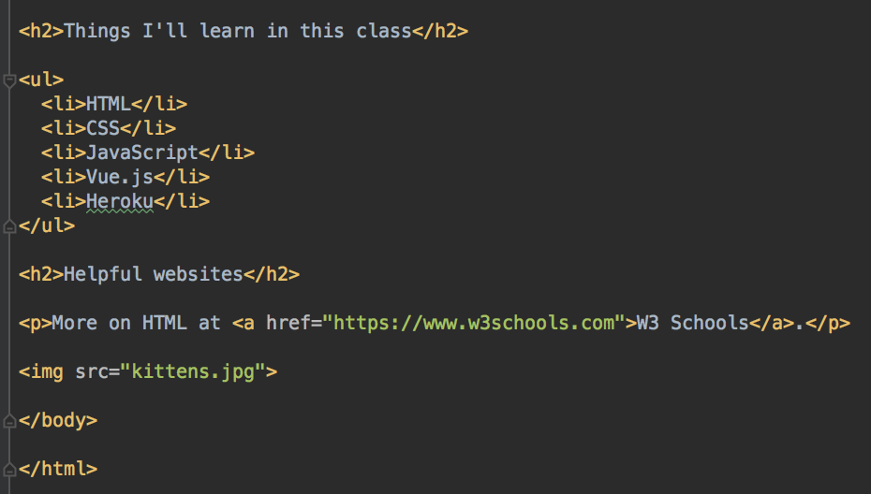
Your Turn - add your image to the page
Example
<img src="image_filename.jpg">
Top of page omitted

Slide 50
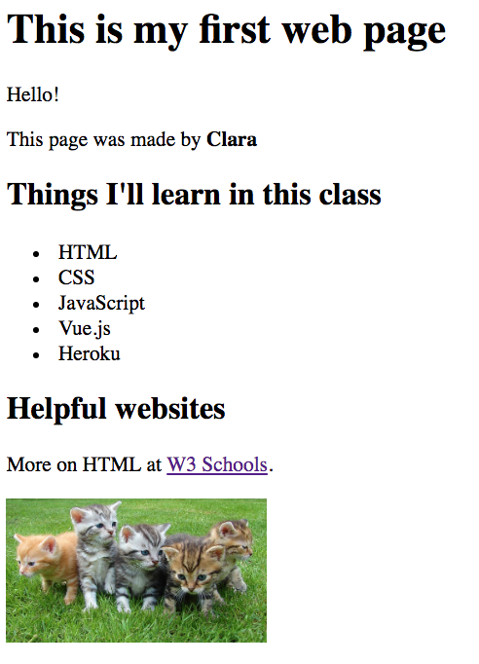
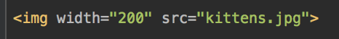
Your turn - set the size
Set the width and/or height of your image
What happens if you only set the width or only the height?
What happens if you set the width and height? Is the image distorted?

Slide 51
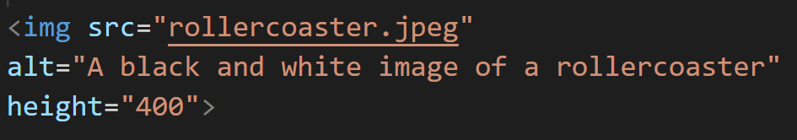
Your turn
Set the alt attribute to set the alt text
Will be displayed if the original image is not found
Will be read by screen readers, important for accessibility of your site
Example

Slide 52
HTML Comments
<!-- This is a comment -->
Comments must be all on one line

Slide 53
Essentials: HTML and CSS
CSS: Cascading Style Sheets
Configures the appearance of your HTML elements - color, position, size, font, borders, animation…
Can specify a particular style for all elements of a particular type
So can use CSS to make all of the page header text bold and 20-point in size and green
Or make all of your images 100 x 100 pixels and give them all a blue 1-pixel border
Or can select some components and apply a style
Select all elements with a certain class
Select the element with a certain ID
Select the last element of a type on the page
Select only elements by context e.g. only list items in ordered lists, but not in unordered lists

Slide 54
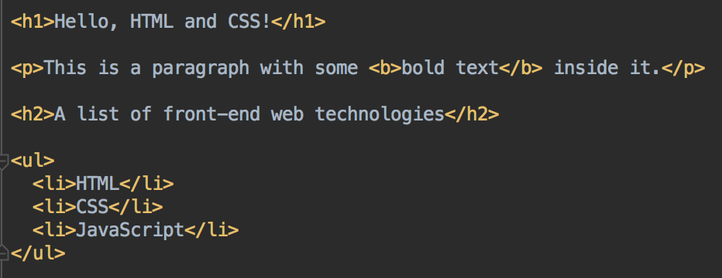
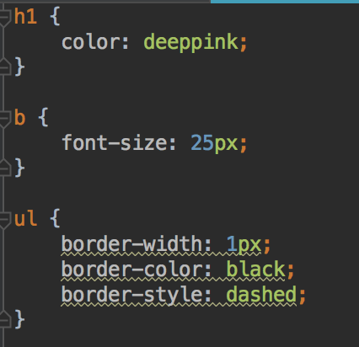
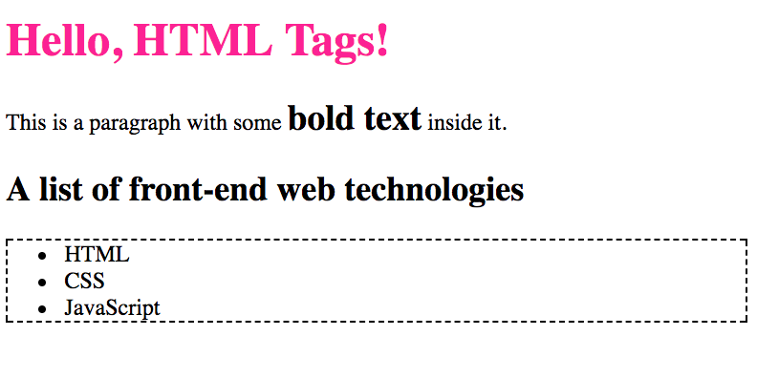
HTML and CSS

Slide 55
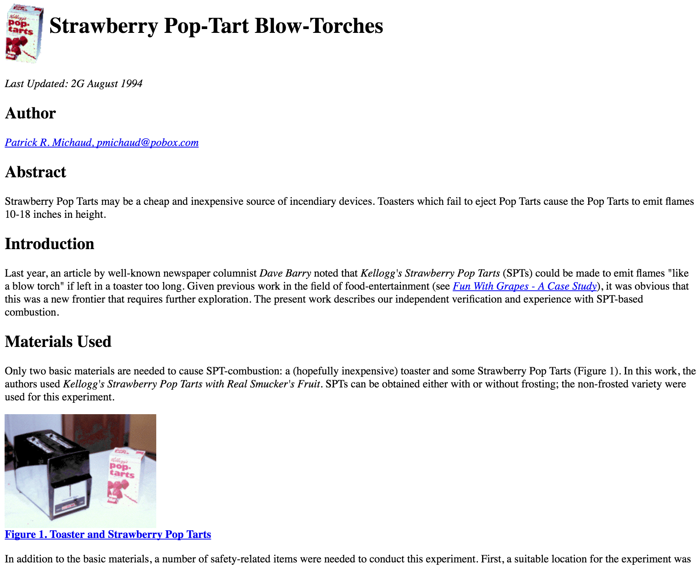
Essentials: HTML and CSS
In the olden days…
Websites specified elements and layout/styles in one document
Works, but harder to change one or the other.
CSS was used more sparingly
Old site, no CSS

Slide 56
Essentials: HTML and CSS
Today: HTML and CSS are treated as independent technologies that work together to create a page
HTML to describe the page content
CSS to describe what it looks like.
Keeping HTML and CSS separate enables independent re-use of content and styles; make change easier
Designers, developers and content creators can work more independently

Slide 57
Essentials: HTML and CSS
Typical roles:
a web developer would make sure the correct elements are on the page, ensure correct functionality; mainly using HTML
a web designer would write CSS to create the correct layout and appearance
Content creators would generate the actual content
As web developers, we'll need to provide HTML that CSS can be applied to - with appropriate elements; and giving elements useful class, id and other attributes
Complex CSS is more for web designers; but developers find it useful and use it too

Slide 58
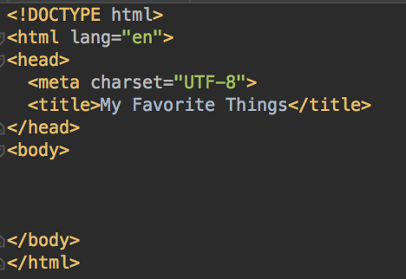
Your Turn - Favorites Page (Start of Lab 1)
Create a new file: favorites.html
Start with the template HTML (see slide 29)
Set the title to My Favorite Things
You'll add content inside the <body> .... </body> element
Set the title
Add page content here

Slide 59
Add content to favorites.html
Add a header h1 element, with text "Some of my favorite things"
Add a h2 element with text "Favorite Movie"
Add a p paragraph of text, a short description of one of your favorite movies
Include an a link to a website about that movie.
The name of the movie should be in i italic text.
Add a h2 element with text "Favorite Music"
Add a p paragraph about your favorite band, artist, or musical performer
Include an a link to the band/artist website.
The name of the band should be in b bold text.
Add a h2 element with text "Favorite Foods"
Add an unordered ul (bullet point) list of your 3 favorite foods

Slide 60
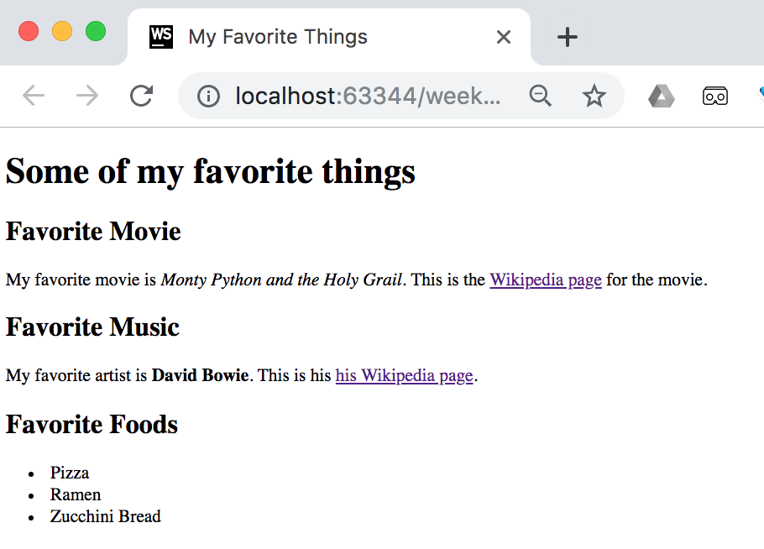
Check your page in your browser
Save favorites.html and load page in your browser
Make sure all of your content is shown
Make sure the title is displayed
Check the links work when clicked
Check the title is displayed in the browser tab

Slide 61
Styles for favorites.html
Currently, your page is the default font, and black text on white background
Let's use CSS to add some styles to the page

Slide 62
CSS: Cascading Style Sheets
CSS is used to modify the appearance of a page
CSS is can select particular element(s) and apply style(s) to that element
For example, you can use CSS to select all of the h2 elements, and make the text green
Add a border
Set the font, size, or text style
Set the position on the page
Add a background image or gradient
Many, many other style attributes

Slide 63
HTML and CSS

Slide 64
CSS: Cascading Style Sheets
As you build your HTML, think about what elements will need to be styled
Decide which elements you want to give a particular style
For example, all of the elements of one type?
All of the elements with a particular class?
Create a CSS selector to select only those elements
In the selector, declare the styles for that element
Repeat for each style needed
You need to link the stylesheet to your HTML page
The browser will apply styles to all the elements that match the selection

Slide 65
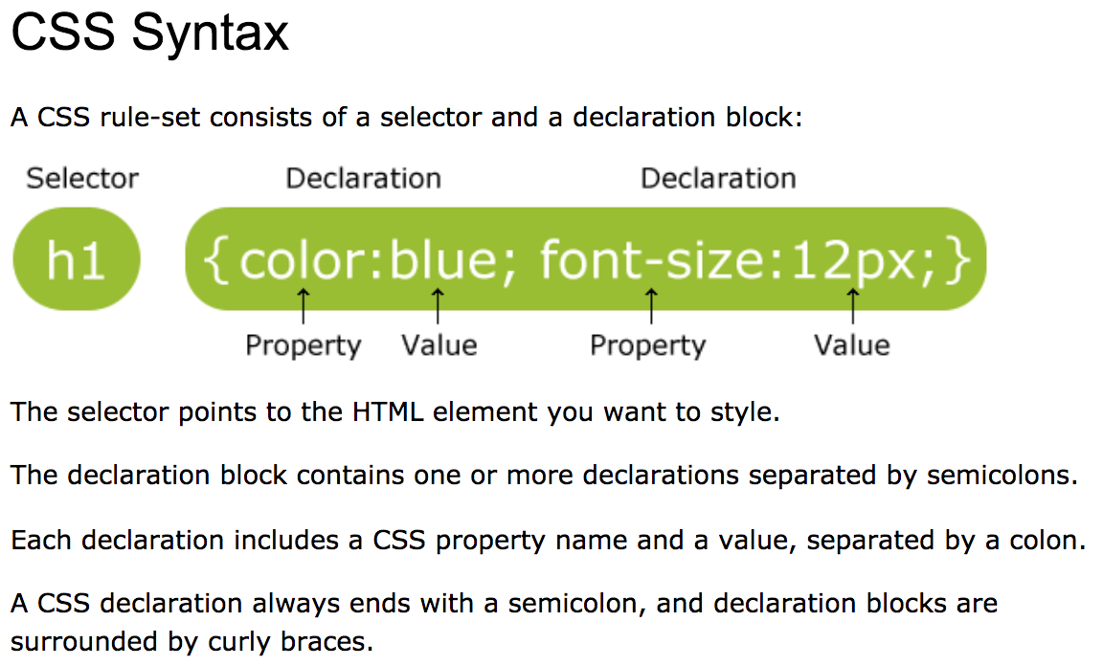
CSS Syntax
W3Schools.com https://www.w3schools.com/css/css_syntax.asp

Slide 66
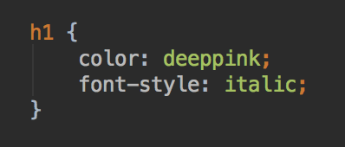
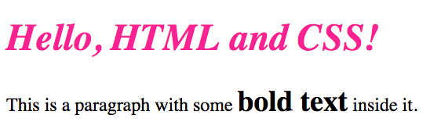
CSS Syntax
selector {
property: value;
property2: value2;
}
Add as many style declarations as you need
CSS is picky about syntax. if your styles don't appear, look for syntax errors in your CSS

Slide 67
CSS Syntax
Specify properties as property: value;
Each property should end with a semi-colon
Not case sensitive, but lowercase is most common
/* Add comments like this */
Lots of CSS properties, see book or W3Schools guide/CSS reference http://www.w3schools.com/css/default.asp
A visual CSS reference: http://cssreference.io/

Slide 68
Styles for favorites.html
Currently, your page is the default font, and black text on white background
Let's use CSS to add some styles
Create a file called style.css and save in the same directory as favorites.html
style.css on the next slide

Slide 69
style.css p, h1, body are CSS selectors
p {
color: blue;
}
h1 {
color: white;
}
body {
background-color: orange;
}
/* Change these colors to colors of your choice. */
List of valid HTML color names https://www.w3schools.com/colors/colors_names.asp

Slide 70
style.css
This file is an external style sheet
Need to tell your HTML page where to find it
Then, when the page is loaded, your browser will locate the stylesheet, and apply the styles defined to the relevant HTML elements
Modify favorites.html as in the following slide
Add a link tag with the location of style.css
Refresh the browser - do you see the colors?

Slide 71
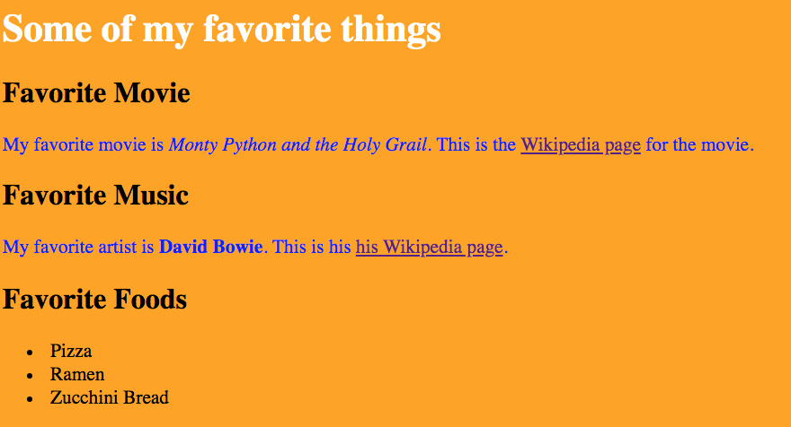
favorites.html
<!DOCTYPE html>
<html>
<head>
<title>My first web page</title>
<link rel="stylesheet" type="text/css" href="style.css">
</head>
<body>
<h1>My Favorite Things</h1>
.... content here ....
</body>
</html>

Slide 72
Verify styles are loaded
Troubleshooting no styles
Have you saved both files, favorites.html and style.css?
Are both files in the same directory
Check the <link> element is in the head element of favorites.html and carefully verify all the attributes are correct
Check the spelling of your filenames
Any syntax errors in style.css?
Make sure you've used valid color names
Your editor might show you errors or warnings - fix these
Still not working? Let me know

Slide 73
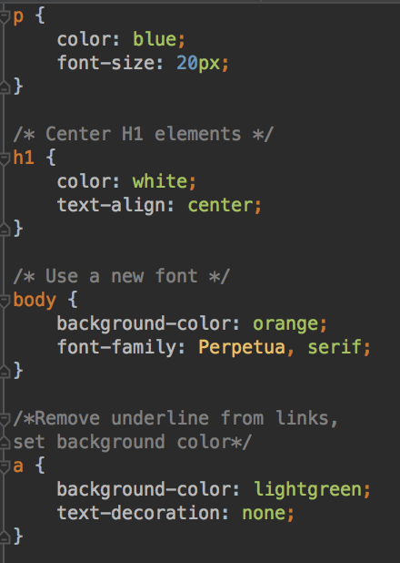
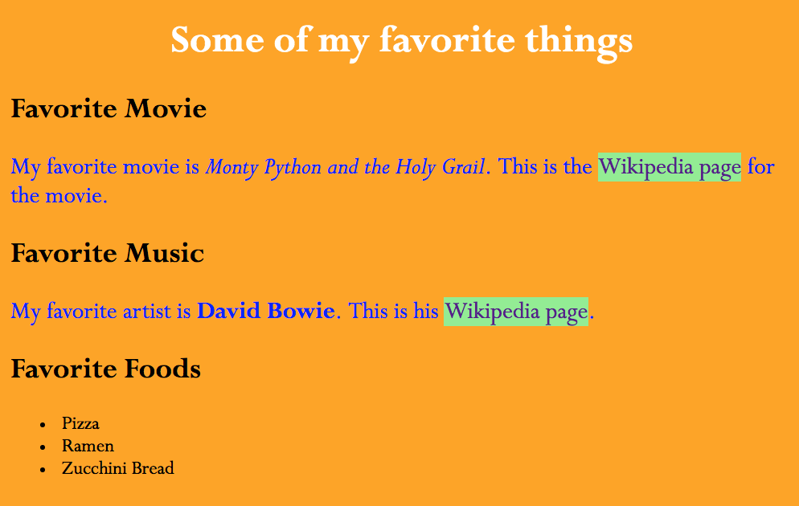
More Styles
Edit style.css to add more CSS styles.
Use your own colors, fonts, and sizes
Web-safe font list https://www.cssfontstack.com/
Can you add a background color to your unordered list?
Can you add a style to your li list items?
Save and refresh the page to see the new styles.

Slide 74
Being more selective
So far, you've been able to apply a style to every header, or every paragraph
What if you only want to style some paragraphs? Or only some of the text in a paragraph?
Solution
Adding class and id attributes to help select elements
and/or
Adding div and span elements to group or subdivide the page, can be selected by CSS

Slide 75
class and id HTML Attributes
Can add two types of HTML attributes to elements to enable CSS to select these elements: id and class
id is for identifying one unique element on a page
class is for giving elements a particular type
Used for selecting particular elements to apply styles to (now)
And for selecting particular element(s) to work with in JavaScript (in a few weeks)
Also useful for automatic tests on pages

Slide 76
HTML class and id attributes
May be added to any HTML element
You define the attribute values
the class attribute specifies a type of element
Many elements can have the same class
Two li elements have the class="important"
the id attributes uniquely identifies one element
Only one element on a page can have a specific id
The ul elements has the id="todo-list"
<ul id="todo-list">
<li class="important">Pay electric bill</li>
<li>Walk dog</li>
<li class="important">Grade papers</li>
<li>Shovel snow</li>
</ul>

Slide 77
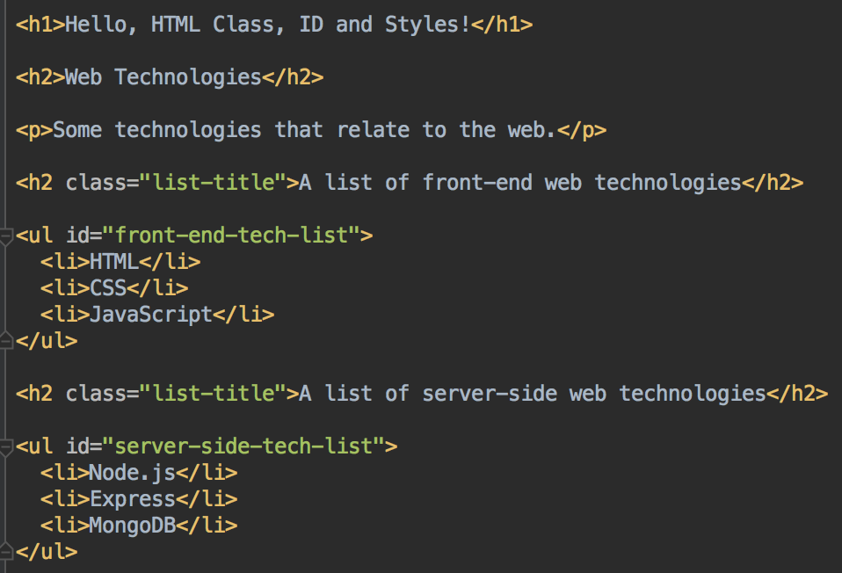
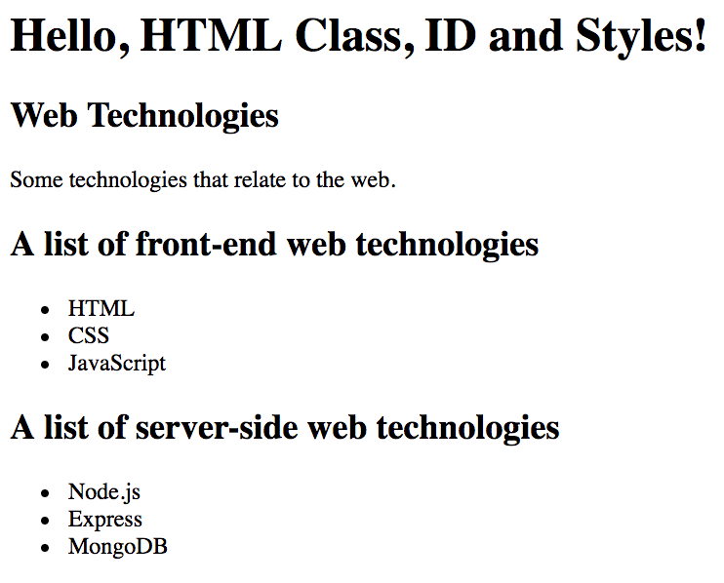
Adding class and id attributes to HTML
By themselves, class and id attributes don't make a difference to how the page renders
Can you see the class and id attributes?

Slide 78
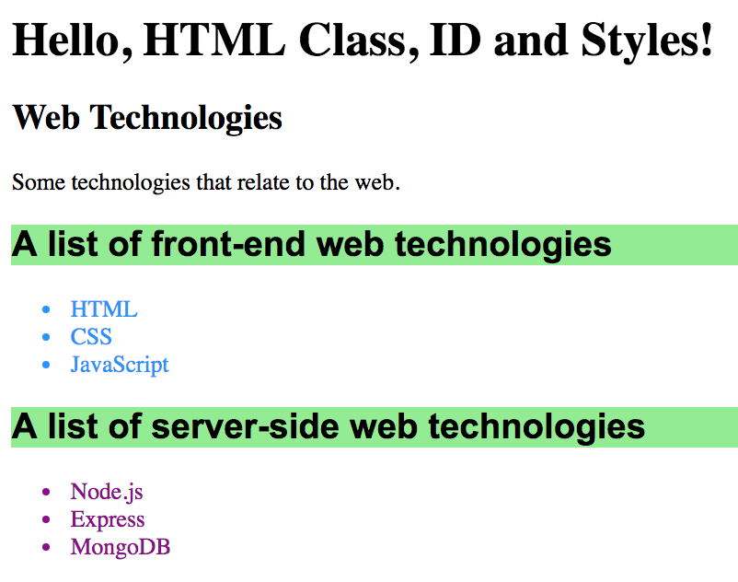
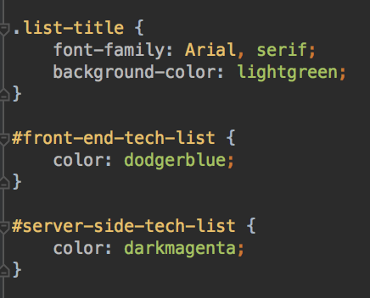
Selecting by class and id
Use #id-value to select by id
Use .class-name to select by class
Use the same property:value; syntax

Slide 79
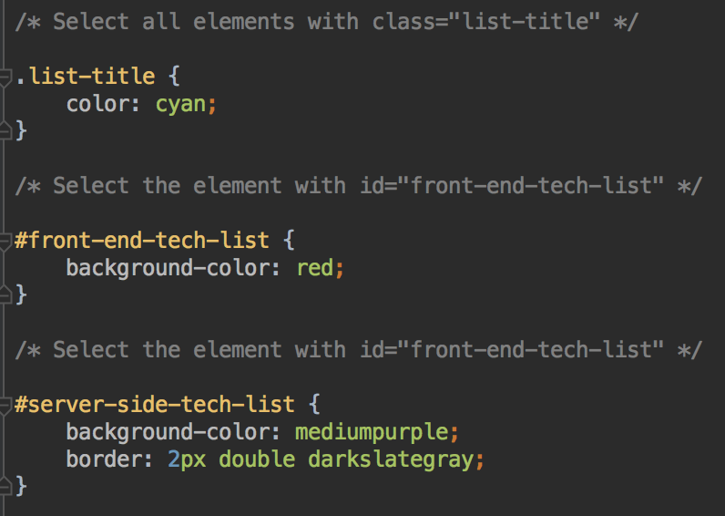

Use any styles you like

Slide 80

Your turn
Add the id="page-title" to Some of my favorite things h1 element at the top of your page
In style.css, add a style to just this element using # notation. Use any style you like

Slide 81


Test
Verify your styles are applied to the h1
Add another h1 element to your page, with your name
Verify that it does not have your style applied
Only the h1 element with id #page-title has the text-shadow style

Slide 82


Organization: div and span
<div> divider, for dividing text into logical sections. div is a block tag. One div will be placed after another.
<span> are inline tags - a span element will directly follow after the preceding element, and be directly followed by the next element.
Otherwise, not visible in your page unless you use them to apply certain styles
span and div are not very useful without class and id attributes

Slide 83

Your Turn - add div and span
Modify your favorites.html web page
Add div tags to organize it into sections; and span tags
Surround all the movie content (the h2 and paragraph) with a div
Surround the movie title with a span (outside or inside <i> tags)
Surround the favorite music content (h2 and paragraph) with a div
Surround the artist name with a span (outside or inside <b> tags)
Surround the favorite food section (h2 and unordered list) with a div

Slide 84
id attributes in HTML
Add id attribute id="favorite-music-name" to your favorite band/artist/musician span element
Examples:
<p>A musician I like is
<span id="favorite-music-name"><b>Chance the Rapper</b></span>.</p>

Slide 85


Selecting by id in CSS
In style.css, use # notation to select the element with the id="favorite-music-name"
Add style(s) of your choice
for example, add the background-color style

Slide 86
class attributes
Use to identify more than one element that will have the same style applied
Elements with the same class don't have to be the same type, but they often are
Add the attribute class="favorite-section" to all of your div elements
<div class="favorite-section">
<p>A band I like is
<b><span id="favorite-music-name">REM</span></b>.
Their website is <a href="http://www.remhq.com/">here</a>.
</p>
</div>
<div class="favorite-section">
<p>Some food I like is....</p>
</div>

Slide 87




Selecting by class, HTML and CSS
Use the . notation in CSS to select all elements with a particular class
HTML
Add CSS

Slide 88


Your turn: select class in style.css
In style.css, add a border and margin to each of your favorite-section elements in this form
border: width color style;
/* style can be dotted, dashed, double, groove, ridge... */
Optional - add any other styles you like

Slide 89

Padding, Borders and Margin
All elements have border, padding, and margin - although the width of these may be 0 so may not be visible
Border surround elements
Padding separates the content (text, image) from the border
Margin separates one element from another
http://www.w3schools.com/css/css_boxmodel.asp

Slide 90
Padding, Borders and Margin
CSS treats every element on your page as being inside a rectangular box
Each box has a margin, border, padding, and content
CSS can set the size of the content
CSS can customize the width of margin, padding, border
Can set the padding or margin on all the sides at once, or set top, left, right, bottom sides individually
Same for borders - can set all borders at once, or set the width, color, and style separately on each side

Slide 91



Example: setting margin - separation of element from it's neighbors
Sets the same margin on all sides
Set the margin, only left side
How do you think you set just the margin at the top, right or bottom?

Slide 92


Setting padding - between content and border
Very similar to setting margin
Still works even if there's no border styles
All elements always have a border with width = 0 if no other style is applied

Slide 93

Hello Chrome Dev Tools
PCs - press F12
Macs - press Option + Command + I
Very quick tour
There's MANY
more tools here
Explore!

Slide 94

Using class and id together
Can add both class and id attributes if needed
So if you wanted to add the same styles to all the animal-info paragraphs,
And some more styles to cat-data
And some more, different styles to squirrel-data
You could add these class and id attributes

Slide 95
Other ways to select elements
Sometimes, you'll want to differentiate between some of the same tags by context or position
By context, e.g. all bold text in an ordered list
Or the every other item of a type on a page
Or the first element of a type, or the last element of a type
All the different ways to select elements: W3Schools CSS selectors reference https://www.w3schools.com/cssref/css_selectors.asp

Slide 96



Cascading Styles
Since there's many ways to select elements, it's possible that an element can be selected by more than one selector
Elements will receive all the styles from all the selectors that match them
In this example, the p selector and the #welcome selector both select the p element, so all styles are applied

Slide 97



Cascading Styles
But what if there's a conflict?
For this element
And this stylesheet
the first selector selects all p elements
the second selects the element with id="welcome"
So both selectors will select the element
But, they both define a background-color style
What color will the background be?
The most specific selector will apply
So styles from selecting by id override selecting by class, and selecting by class overrides selecting by tag

Slide 98

<!DOCTYPE html>
<html lang="en">
<head>
<meta charset="UTF-8">
<title>To Do</title>
<link rel="stylesheet" type="text/css" href="style.css">
</head>
<body>
<h1>To Do List</h1>
<P>The important tasks are <span class="important">highlighted in red</span>.</P>
<div id="thisweek">
<h2>This week</h2>
<ul>
<li class="important">Shovel snow</li>
<li>Renew car's tags</li>
<li>Tidy my office</li>
<li class="important">Buy new gloves</li>
</ul>
</div>
<div id="nextweek">
<h2>Next week</h2>
<ul>
<li class="important">Grade assignments</li>
<li>Go to department meeting</li>
<li>Clean out basement</li>
</ul>
</div>
</body>
</html>
/*Apply to all <li> tags*/
li {
color : darkblue;
}
/*Apply to all tags with class = "important". In this example,
two types of element have this class - some li elements and a span.
Notice how this overrides the li selector above for important li elements.
CSS will apply the most specific selector.*/
.important {
color : red
}
/* This applies to the element with id = "thisweek". Notice how
the style is also applied to the elements within this div element. */
#thisweek {
font-weight: bold;
}
/* Apply a style only to the
element with id='nextweek'*/
#nextweek {
font-style : italic;
}

Slide 99
Lab 1
Continue working on your Favorite Things web page
Add some more information on your favorite movie, music, and foods
Add some images you like
Create a favorite books table
Directions in D2L

Slide 100

More HTML: Tables
<table>, <tr>, <th>, <td> for creating tables
<tr> for a table row
<th> for header rows, <td> for table data elements
Notice how elements are nested
The bold text for headers is a default style applied by your browser. Can override with CSS
<table> <tr><th>Radio Station</th><th>Frequency</th></tr> <tr><td>The Current</td><td>89.3</td></tr> <tr><td>KFAI</td><td>90.3</td></tr> </table>

Slide 101
Lab 1
Lab 1 worksheet and instructions for submitting the lab is in D2L
You'll have a week to work on each lab
Typically start the lab on Tuesday or Wednesday
Work on lab in class
Work on any remaining lab work during the week
Lab is due before the next Tuesday class

Slide 102
Questions? Need Help?
Please ask!
In your future job as a software developer or related occupation, you will be expected to seek feedback on your work
So you can improve and build your skills; and verify that what you are working on is what your employer expects
Practice now :)

